Slide 1
Process Models

Slide 2
Lesson outline
Understanding the process model
Types of process models
Adapting process model
Assessing / validating process models

Slide 3
Addressing What / who / why is Process Models?
What: Go through a series of predictable steps--- a road map that helps you create a timely, high-quality results.
Who: Software engineers and their managers, clients also. People adapt the process to their needs and follow it.
Why: Provides stability, control, and organization to an activity that can if left uncontrolled, become quite chaotic. However, modern software engineering approaches must be agile and demand ONLY those activities, controls and work products that are appropriate.
What Work products: Programs, documents, and data
What are the steps: The process you adopt depends on the software that you are building. One process might be good for aircraft avionic system, while an entirely different process would be used for website creation.
How to ensure right: A number of software process assessment mechanisms that enable us to determine the maturity of the software process. However, the quality, timeliness and long-term viability of the software are the best indicators of the efficacy of the process you use.

Slide 4
Definition of Software Process
A framework for the activities, actions, and tasks that are required to build high-quality software.
SP defines the approach that is taken as software is engineered.
Is not equal to software engineering, which also encompasses technologies that populate the process– technical methods and automated tools.

Slide 5
Software process
A generic process framework for software engineering defines five framework activities-communication, planning, modeling, construction, and deployment as stated earlier.
In addition, a set of umbrella activities- project tracking and control, risk management, quality assurance, configuration management, technical reviews, and others are applied throughout the process.
Next question is: how the framework activities and the actions and tasks that occur within each activity are organized with respect to sequence and time? .

Slide 6
Process Flow
process flow—describes how the framework activities and the actions and tasks that occur within each framework activity are organized with respect to sequence and time.
A linear process flow executes each of the five framework activities in sequence, beginning with communication and culminating with deployment.
An iterative process flow repeats one or more of the activities before proceeding to the next.
An evolutionary process flow executes the activities in a “circular” manner. Each circuit through the five activities leads to a more complete version of the software.
A parallel process flow executes one or more activities in parallel with other activities.

Slide 7
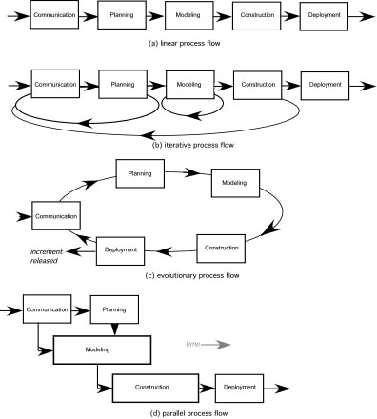
Process flow: Pictorial view

Slide 8
Types of process models
Prescriptive models: A prescriptive model prescribes how a new software system should be developed.
Models stress detailed definition, identification, and application of process activates and tasks.
Intent is to improve system quality, make projects more manageable, make delivery dates and costs more predictable, and guide teams of software engineers as they perform the work required to build a system.
Unfortunately, there have been times when these objectives were not achieved.
More structured
If prescriptive models are applied dogmatically and without adaptation, they can increase the level of bureaucracy.

Slide 9
Types of process models
Agile models: Emphasize project “agility” and follow a set of principles that lead to a more informal approach to software process.
It emphasizes maneuverability and adaptability.
It is particularly useful when Web applications are engineered
Dynamic and code reusability
Informal approach
Time box
Constant feedback and client involvement
Fast changing environments.
Requirements unclear
Complex and many stakeholders
Also known as evolutionary models

Slide 10
Prescriptive Models
Waterfall model
Incremental
V-model

Slide 11
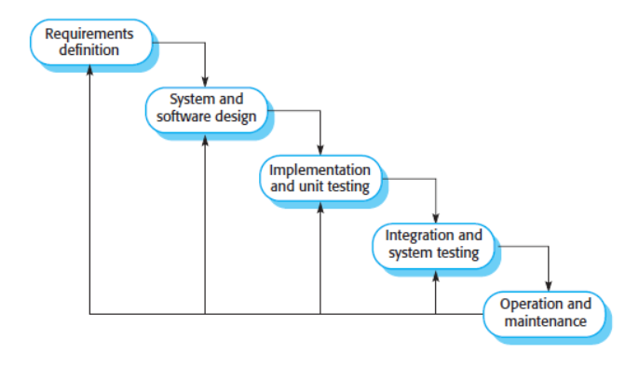
The Waterfall Model

Slide 12
The Waterfall Model
The waterfall model, sometimes called the classic life cycle, suggests a systematic, sequential approach to software development that begins with customer specification of requirements and progresses through planning, modeling, construction, and deployment, culminating in ongoing support of the completed software.
The waterfall model is the oldest paradigm for software engineering. However Among the problems that are sometimes encountered when the waterfall model is applied are:
The classic life cycle leads to “blocking states” in which some project team members must wait for other members of the team to complete dependent tasks. In fact, the time spent waiting can exceed the time spent on productive work.
The difficulty of accommodating change after the process is underway.

Slide 13
characteristics
The ‘classic mode.’
  Still in wide use today.
  Captures the major building blocks in development
  Linear sequence
  Highly structured; plan-driven; Heavy-weight process
  Product delivered for evaluation and deployment at the end of development and testing
  Big bang approach
  Used for major projects of length
  But serves as a framework for other models

Slide 14
Stages/ phases of waterfall model
Requirements analysis and definition: The system’s services, constraints, and goals are established by consultation with system users. They are then defined in detail and serve as a system specification.
System and software design: The systems design process allocates the requirements to either hardware or software systems. It establishes an overall system architecture. Software design involves identifying and describing the fundamental software system abstractions and their relationships.
Implementation and unit testing: During this stage, the software design is realized as a set of programs or program units. Unit testing involves verifying that each unit meets its specification.

Slide 15
Stages/ phases of waterfall model
Integration and system testing: The individual program units or programs are integrated and tested as a complete system to ensure that the software requirements have been met. After testing, the software system is delivered to the customer.
Operation and maintenance: Normally, this is the longest life-cycle phase. The system is installed and put into practical use. Maintenance involves correcting errors that were not discovered in earlier stages of the life cycle, improving the implementation of system units, and enhancing the system’s services as new requirements are discovered.
In principle, the result of each phase in the waterfall model is one or more documents that are approved (“signed off”). The following phase should not start until the previous phase has finished.

Slide 16
Incremental model
Incremental development is based on the idea of developing an initial implementation, getting feedback from users and others, and evolving the software through several versions until the required system has been developed.
Specification, development, and validation activities are interleaved rather than separate, with rapid feedback across activities.

Slide 17
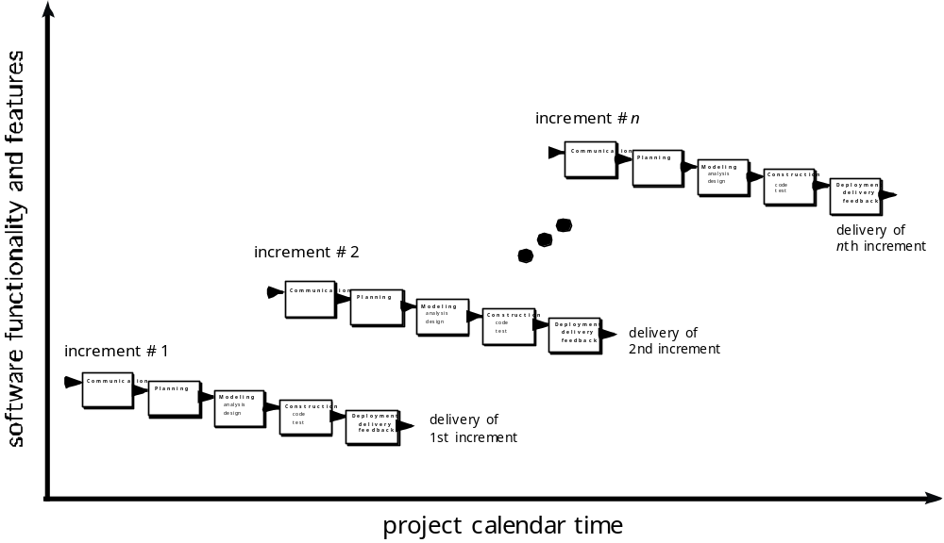
Incremental model

Slide 18
Incremental
When initial requirements are reasonably well defined, but the overall scope of the development effort preclude a purely linear process. A compelling need to expand a limited set of new functions to a later system release.
It combines elements of linear and parallel process flows. Each linear sequence produces deliverable increments of the software.
The first increment is often a core product with many supplementary features. Users use it and evaluate it with more modifications to better meet the needs.
Early increments are stripped-down versions of the final product, but they do provide capability that serves the user and also provide platform for evaluation by the user.

Slide 19
Example
For example, word-processing software developed using the incremental paradigm might deliver:
  Basic file management, editing, and document production functions in the first increment.
  More sophisticated editing and document production capabilities in the second increment.
  Spelling and grammar checking in the third increment.
  Advanced page layout capability in the fourth increment.

Slide 20
Reading assignment
Read about V- Modell, a variation of a waterfall model

Slide 21
Evolutionary process models (sub category under prescriptive
Prototype
Spiral
Unified process
Assumes systems evolve
Still stick to its plan
Accommodate change
Bottom up approach

Slide 22
Evolutionary process
Software system evolves over time as requirements often change as development proceeds. Thus, a straight line to a complete end product is not possible.
However, a limited version must be delivered to meet competitive pressure.
Usually a set of core product or system requirements is well understood, but the details and extension have yet to be defined.
You need a process model that has been explicitly designed to accommodate a product that evolved over time.
It is iterative that enables you to develop increasingly more complete version of the software.

Slide 23
Prototyping
The prototyping model is a systems development method in which a prototype is built, tested and then reworked as necessary until an acceptable outcome is achieved from which the complete system or product can be developed.
When to use: Customer defines a set of general objectives but does not identify detailed requirements for functions and features. Or Developer may be unsure of the efficiency of an algorithm, the form that human computer interaction should take.
Begins with communication by meeting with stakeholders to define the objective, identify whatever requirements are known, outline areas where further definition is mandatory.

Slide 24
Prototyping
A quick plan for prototyping and modeling (quick design) occur. Quick design focuses on a representation of those aspects the software that will be visible to end users. ( interface and output). Design leads to the construction of a prototype which will be deployed and evaluated.
Stakeholder’s comments will be used to refine requirements.
Both stakeholders and software engineers like the prototyping paradigm. Users get a feel for the actual system, and developers get to build something immediately.
However, engineers may make compromises in order to get a prototype working quickly.
The less-than-ideal choice may be adopted forever after you get used to it.

Slide 25
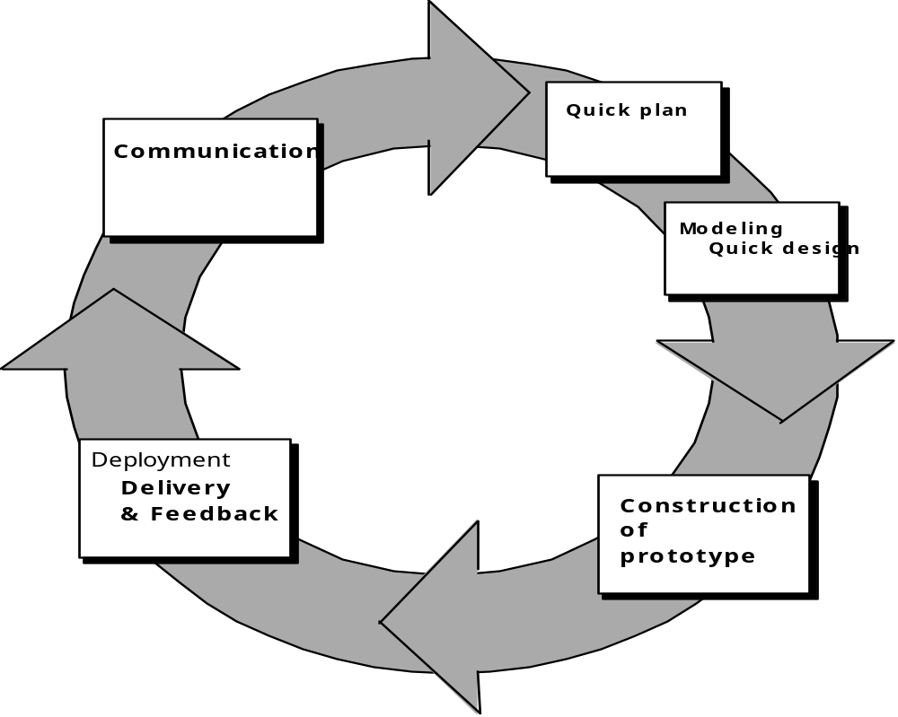
prototyping
Quick
plan
communication
Modeling
Quick design
Deployment
delivery &
feedback
Construction
of prototype

Slide 26
The Spiral
The spiral model is an evolutionary software process model that couples the iterative nature of prototyping with the controlled and systematic aspects of the waterfall model.
It is a risk-driven process model generator that is used to guide multi-stakeholder concurrent engineering of software intensive systems.
Two main distinguishing features: one is cyclic approach for incrementally growing a system’s degree of definition and implementation while decreasing its degree of risk. The other is a set of anchor point milestones for ensuring stakeholder commitment to feasible and mutually satisfactory system solutions.
A series of evolutionary releases are delivered. During the early iterations, the release might be a model or prototype. During later iterations, increasingly more complete version of the engineered system are produced.

Slide 27
Spiral
The first circuit in the clockwise direction might result in the product specification; subsequent passes around the spiral might be used to develop a prototype and then progressively more sophisticated versions of the software.
Each pass results in adjustments to the project plan. Cost and schedule are adjusted based on feedback. Also, the number of iterations will be adjusted by project manager.
Good to develop large-scale system as software evolves as the process progresses and risk should be understood and properly reacted to. Prototyping is used to reduce risk.
However, it may be difficult to convince customers that it is controllable as it demands considerable risk assessment expertise.

Slide 28
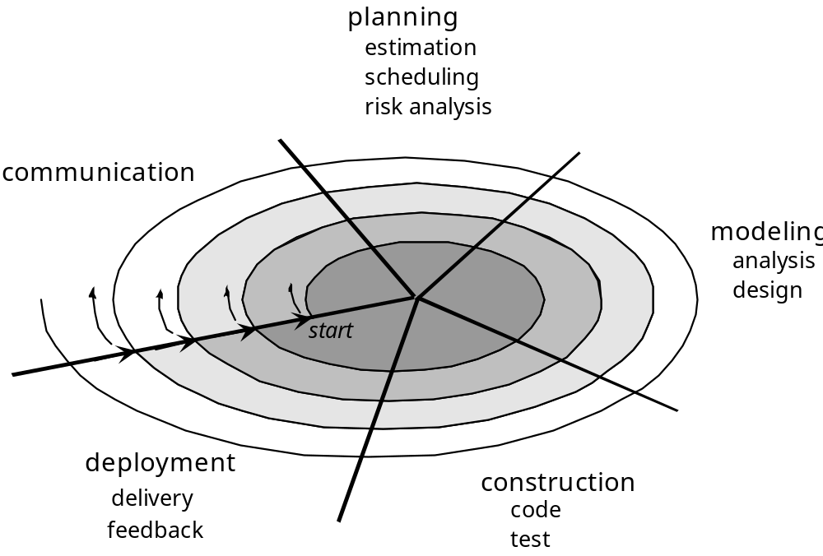
Spiral

Slide 29
Adapting the process model
It is a process of designing, developing, deploying and even maintaining a software for a specific set of users.
It includes three main factors: People, Product and Process .
The objective of many software developers is to deliver software products that meet and or exceed customer expectations.
The key to achieving this is to capture these expectations at the beginning of the project by clearly defining all quality requirements.
The generic model is intended to be applicable to any type of software product or intermediate product.
However before the model is applied, care must be taken

Slide 30
Adapting the process model
Before application this model needs to be tailored to a specific software and specific need.
Things to consider:
Understand the people: users, sponsors and fellow programmers, their behavior and fit them in your plan.
Understand the product to be developed.
Break complex tasks into fine and unambiguous actions that will lead to deliverables.
Set timelines of each associated tasks
Check whether the project is a short term, medium term or long term

Slide 31
Adapting the process model
Set organization goals
Fit the tasks broken into different process models
Validate each model against time required to deliver the product, complexity of the product, how heavy or light the model is, customer involvement.
Select the model that best suit the work at hand.

Slide 32
Assessing / validating process models
SP cannot guarantee that software will be delivered on time, meet the needs, or has the desired technical characteristics.
However, the process can be assessed to ensure that it meets a set of basic process criteria that have been shown to be essential for a successful software engineering.
The current thinking among most engineers is that software processes and activities should be assessed using numeric measures or software analytics (metrics).
The metrics may include time bound, user centric and recourse utilization.

